Slide 1
PROJECT
PLANT DISEASES DETECTION

Slide 2
CONTENTS
INTRODUCTION
OBJECTIVES
ADVANTAGES
REAL WORLD IMPACTS
IMPORTANCE OF PLANT DISEASES DETECTION
WHY WE NEED THIS ?
SUMMARY

Slide 3
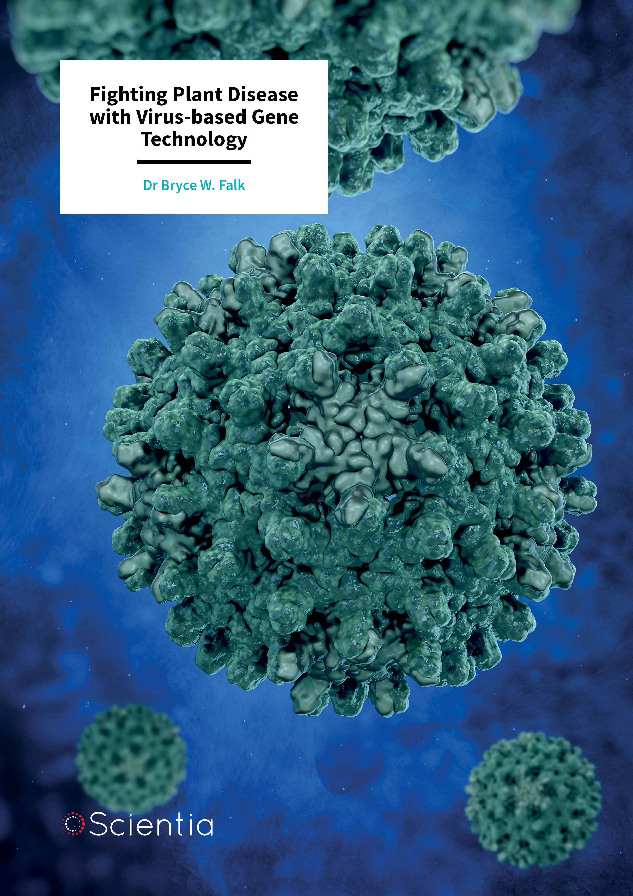
INTRODUCTION
Agriculture plays a crucial role in sustaining the global economy and ensuring food security. However, plant diseases pose a serious threat to crop yield and quality, leading to significant economic losses and food shortages. Early and accurate detection of plant diseases is essential for effective disease management and control.
Traditionally, plant disease diagnosis has relied on manual inspection by experts, which can be time-consuming, labor-intensive, and prone to human error—especially when dealing with large-scale farms. In recent years, the integration of technology in agriculture has opened new doors for improving plant health monitoring.
This Photo by Unknown Author is licensed under CC BY

Slide 4
OBJECTIVES
The objective of plant disease detection is to identify the presence of infections, but certain unique leaf images present challenges to the human eye and are not easily distinguishable without assistance. In our study, we addressed this issue by utilizing GreenViT to visually compare its performance on various datasets. The included figure displays a series of sample leaf images from different datasets. The first row consists of images from the PV, the second row showcases images from the DRLI and the third row represents images from the PC dataset. The second last row contains ground truth (GT) labels, where healthy samples are highlighted in blue text, while infected samples are indicated in red text. Through this visual comparison, we evaluated the effectiveness of GreenViT in detecting plant diseases across different datasets.

Slide 5
ADVANTAGES
Early Detection & Control Prevents spread and minimizes damage to crops
Economic Efficiency Reduces treatment costs and avoids yield losses
Environmental Benefits Lowers chemical use; promotes eco-friendly farming
Precision Farming Support Enables targeted interventions and better crop monitoring
Technology Integration Utilizes AI, drones, and remote sensing for large-scale detection
Improved Food Security Ensures consistent and high-quality food production
Boosts R&D Aids in developing disease-resistant plant varieties

Slide 6
Real world impacts
Plant disease detection plays a crucial role in the real world by improving crop yield and quality through early diagnosis and timely intervention, which helps prevent large-scale losses. It supports food security by ensuring a stable food supply and reduces the overuse of chemicals, thus protecting the environment. Economically, it saves farmers significant costs and boosts productivity, especially when combined with smart farming tools like mobile apps and IoT sensors. By empowering farmers with accessible technology and supporting precision agriculture, plant disease detection also drives innovation in AI and plant sciences, ultimately fostering sustainable farming practices and global agricultural resilience.

Slide 7
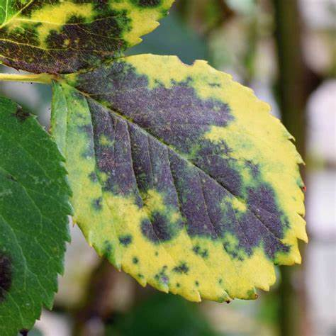
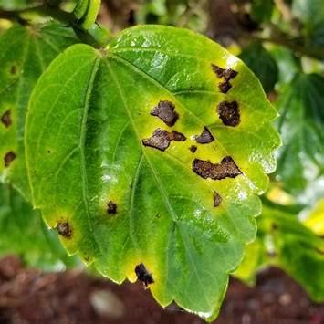
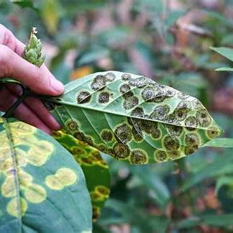
DIFFERENT PLANT DISEASES

Slide 8
Importance of plant diseases detection
The detection of plant diseases is of vital importance in agriculture as it enables early identification and control of infections that can severely impact crop health and yield. Timely detection helps farmers take appropriate measures to prevent the spread of disease, reducing the risk of large-scale crop failure. This not only ensures better productivity and food security but also minimizes economic losses. Moreover, accurate disease detection reduces the unnecessary use of pesticides, promoting more sustainable and environmentally friendly farming practices. As global demand for food continues to rise, effective plant disease detection becomes essential for maintaining healthy crops, supporting farmers’ livelihoods, and ensuring a stable and safe food supply chain.

Slide 9
Why we need this ?
We need plant disease detection because plants are the foundation of our food supply, and diseases can seriously threaten agricultural productivity. Without early detection, infections can spread rapidly, destroying crops, reducing yields, and causing financial losses for farmers. In some cases, this can even lead to food shortages or price hikes. Timely and accurate detection allows for quick action to control outbreaks, use resources like pesticides more efficiently, and protect the environment from overuse of chemicals. It also helps farmers make better decisions, especially in regions where expert advice is hard to access. In short, plant disease detection is essential for ensuring food security, protecting the environment, and supporting sustainable farming.

Slide 10
Summary
Plant disease detection is the process of identifying signs and symptoms of infections caused by pathogens such as fungi, bacteria, and viruses. Early and accurate detection is essential to prevent the spread of disease, reduce crop losses, and ensure high-quality agricultural production. Traditional methods like visual inspection and lab tests are being enhanced by modern technologies such as image processing, machine learning, and mobile applications. These advanced techniques allow for faster, more precise, and large-scale detection, even in remote farming areas. Plant disease detection plays a vital role in sustainable agriculture, environmental protection, and global food security.

